Slide 1
Module 1: Introduction to Configuration Management

Slide 2
Describe Configuration Management (CM), its aim and practices.
Compare the features of Centralized Server and Distributed Server models of Configuration Management.
Define the version control terminologies used in SCM.
Visualize the usage of Configuration Management in SDLC.

Slide 3
Topic List
Configuration Management
Centralized & Distributed Model
Version Control Terminologies
Configuration Management in SDLC

Slide 4
Topic List
Configuration Management
Centralized & Distributed Model
Version Control Terminologies
Configuration Management in SDLC

Slide 5
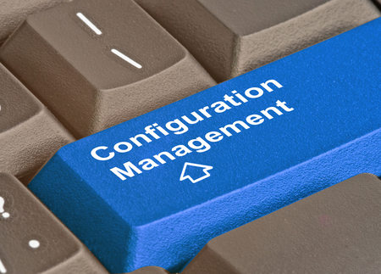
Configuration Management (1)
What is Configuration Management ?
Configuration Management (CM) is a branch for evaluation, co-ordination, acceptance or rejection and applying of changes in artifacts which are used to construct and maintain software system.
CM is the management of artifacts through all the stages of SDLC which includes design, build, test, baselining, release, implementation and maintenance.
Consists of a set of policies and standards which are institutionalized and well defined.
Purpose of CM
It is used to maintain different versions of artifacts without creating a mess.
Artifact in CM
An artifact in CM can be a piece of hardware or software or documentation.

Slide 6
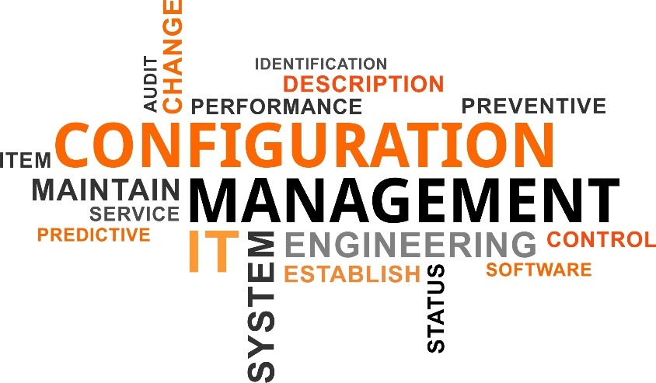
Configuration Management (2)
Key Functionalities
Configuration Management looks after the following things:
Labelling of artifacts.
Setting up the artifacts (configuration items) under a control set.
Adding and deleting an artifact in the control set.
Maintaining the changes made to the artifacts.
Using CM tools to enable configuration management.
Tracking various versions of artifacts.

Slide 7
Configuration Management (3)
Software Configuration Management (SCM)
Software Configuration Management (SCM) is a subset of configuration management which monitors the changes in the software
Aim of SCM
Uses of SCM
To identify configuration items
To perform configuration changes through Change Control Board (CCB), status accounting and auditing
To perform Build Management, Process Management & Environment Management
To track the defects
Maintaining the revision control
Establishing the baselines
Tracking what changes are made
Tracking who made the change

Slide 8
Topic List
Configuration Management
Centralized & Distributed Model
Version Control Terminologies
Configuration Management in SDLC

Slide 9
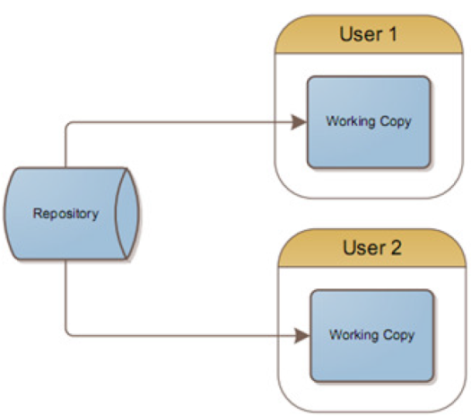
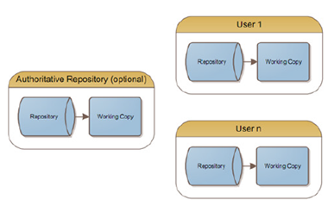
Centralized & Distributed Model (1)
Comparison between Centralized & Distributed Models
Centralized Server and Distributed Server are the types of SCM Server.
Centralized server
Distributed Server
In the Centralized server (client-server) model, developers use a single shared repository.
Single server contains various versions of files.
All the clients/users use the central place from where files are checked out. Users can do “Pessimistic” (centralised) locking during “reserved” checkouts.
Single point of failure.
In the Distributed server model, developer have their own local repository.
Changes are shared between repositories as a separate step/task.
Latest snapshot of files are taken at a particular time of the repository.
In case of failure of a server, any of the snapshots of the repositories which were checked out can be used to restore by copying back to the server. Thus each clone serves as a backup.

Slide 10


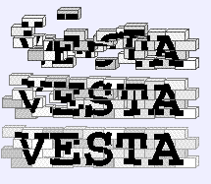

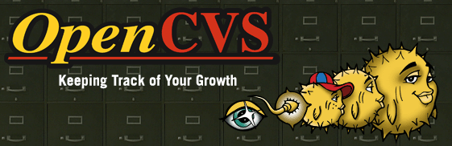

Centralized & Distributed Model (2)
Centralized Server Model Tools
Following are the open source Centralized Server model tools:
Notes:
* Concurrent Versions System (CVS) – originally built on the Revision Control System. * CVSNT – A cross-platform port of CVS that allows case insensitive file names among other changes. * OpenCVS – Compatible with CVS, with emphasis put on security and source code correctness. * Subversion – an open source version control tool started in 2000 to be “a compelling replacement for CVS”[1]. * Vesta – a build system with a versioning file system and support for distributed repositories. Used at Intel for microprocessor design.

Slide 11
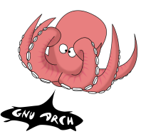

Centralized & Distributed Model (3)
Distributed Server Model Tools
Following are the open source Distributed Server model tools:
Notes:
GNU arch – the original[citation needed] * ArX – started as a fork of GNU arch, but has been completely rewritten. * Monotone – fully-decentralized in a P2P way. * Git – Designed by Linus Torvalds to address the needs of the Linux kernel project * Bazaar – written in Python. Decentralised, and aims to be fast and easy to use. Can losslessly import Arch archives. * Mercurial – written in Python. Decentralised and aims to be fast, lightweight, portable, and easy to use. * Codeville – written in Python, uses an innovative merging algorithm.
ARCS – Automated Revision Control System. A front-end to GIT, CVS, Subversion and Darcs. Allowing real-time file-system monitoring, with the aim of simplification of the revision control process.

Slide 12
Topic List
Configuration Management
Centralized & Distributed Model
Version Control Terminologies
Configuration Management in SDLC

Slide 13
Version Control Terminologies
Key Terminologies
Following are the list of Version Control terminologies used in SCM:
Terms | Description
Repository | A central room for developer's work.
Trunk | A directory checked out for main development work on the project.
Tags | Descriptive names to specific the version (snapshot). Example: LASTSTABLECODE_ Release65 instead of the Repository UUID 7fdggf8cb-5678-40dd-a067-f216ec2e674.
Branches | Different separate spaces for developers. Example: If development process forks off into two different paths i.e when you release version 3.0, a branch is created to keep the development of 4.0 features separately from 3.0 bug-fixes.
Working copy | A snapshot of the repository. The repository is shared with all the teams, but is not modified directly. Instead, each developer checks out an individual working copy which acts as a private workplace for each developer’s work and is isolated from each others.
Commit changes | Updating changes from developer’s workplace to central server, thus the changes available to all. Other developers can pull these changes to update their working copy. At a commit, either the whole commit succeeds or is rolled back, thus is Atomic operation.

Slide 14
Topic List
Configuration Management
Centralized & Distributed Model
Version Control Terminologies
Configuration Management in SDLC

Slide 15
Configuration Management in SDLC
Overview
Configuration Management can be used in Plan, Design, Develop, Testing and Implementation stages of SDLC in order to maintain different versions of designs and code.
Implement
Test
SDLC Stages
Develop
Design
Plan and Analyze

Slide 16

Knowledge Check
State True or False
The purpose of Configuration Management (CM) is to maintain different versions of artifacts without creating a mess.
True
False

Slide 17
Describe Configuration Management (CM), its aim and practices.
Compare the features of Centralized Server and Distributed Server models of Configuration Management.
Define the version control terminologies used in SCM.
Visualize the usage of Configuration Management in SDLC.

Slide 18
https://git-scm.com/book/en/v2/Getting-Started-About-Version-Control

Slide 19
Thank You

